Slide 1
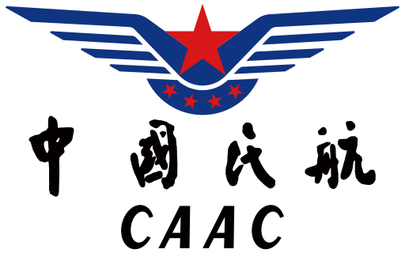
Chinese ATM system Analysis and Solutions
Civil Aviation Administration of China
manage all non-military aviation in China
provide general and commercial flight service
Notes:
The Civil Aviation Administration of China is the aviation authority under the Ministry of Transport of the People's Republic of China. It oversees civil aviation and investigates aviation accidents and incidents.^{[1]} As the aviation authority responsible for China, it concludes civil aviation agreements with other aviation authorities, including those of the Special administrative regions of China which are categorized as "special domestic".^{[2]} It directly operated its own airline, China's aviation monopoly, until 1988. The agency is headquartered in Dongcheng District, Beijing.^{[3]}

Slide 2
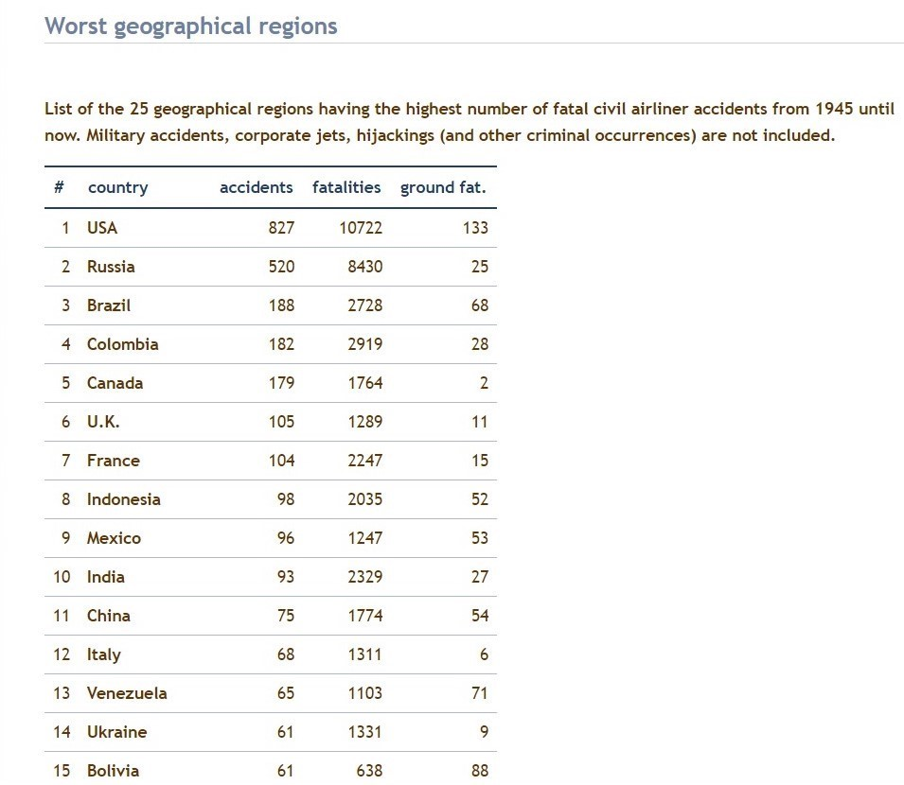
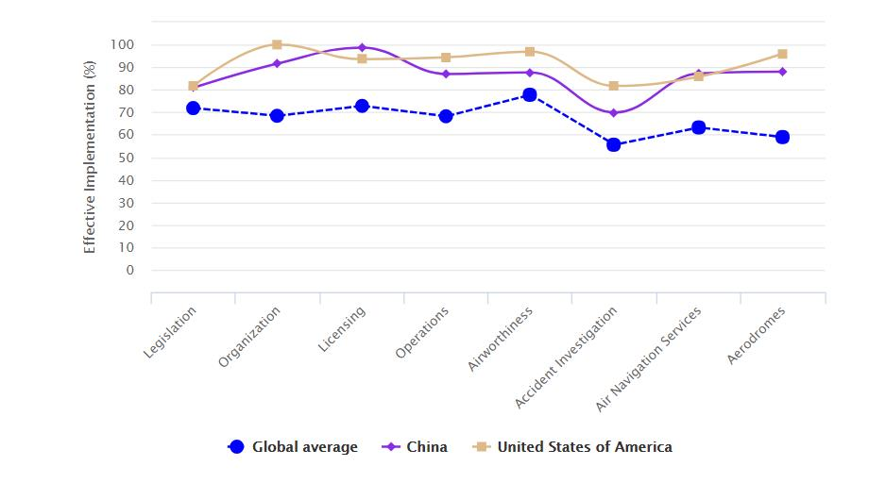
The strengths
Fastest-growing country market and second largest Domestic Aviation market
More airports and more travelers-bigger market
Striving to improve the efficiency of the facilities and takeoff-landing numbers
Very good safety performance

Slide 3
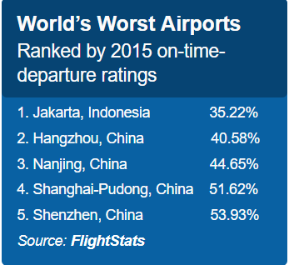
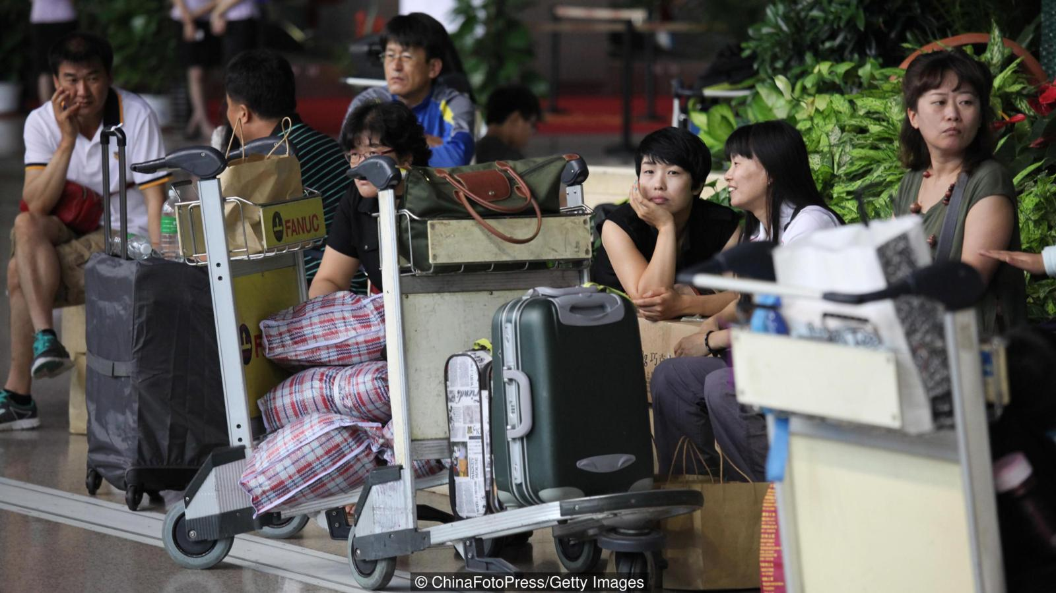
Notorious punctuality record
Low on-time departure rating (punctuality)
Airspace Constraint Issue
Central Military Commission manage the airspace under the regulations in the Civil Aviation Law of the People's Republic of China. CAAC doesn’t the responsibility.
Military has the privilege of airspace
Notes:
-Little Airspace allowed for civilian aircraft to use (less than 30%)
China's airspace is largely controlled by the military, leaving little room for civilian aircraft.
The CAAC does not share the responsibility of managing China's airspace with the Central Military Commission under the regulations in the Civil Aviation Law of the People's Republic of China

Slide 4
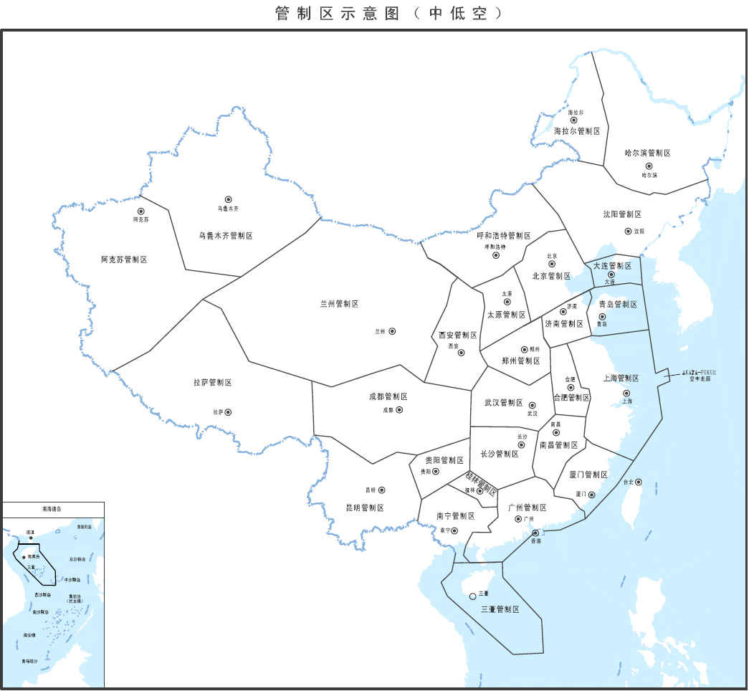
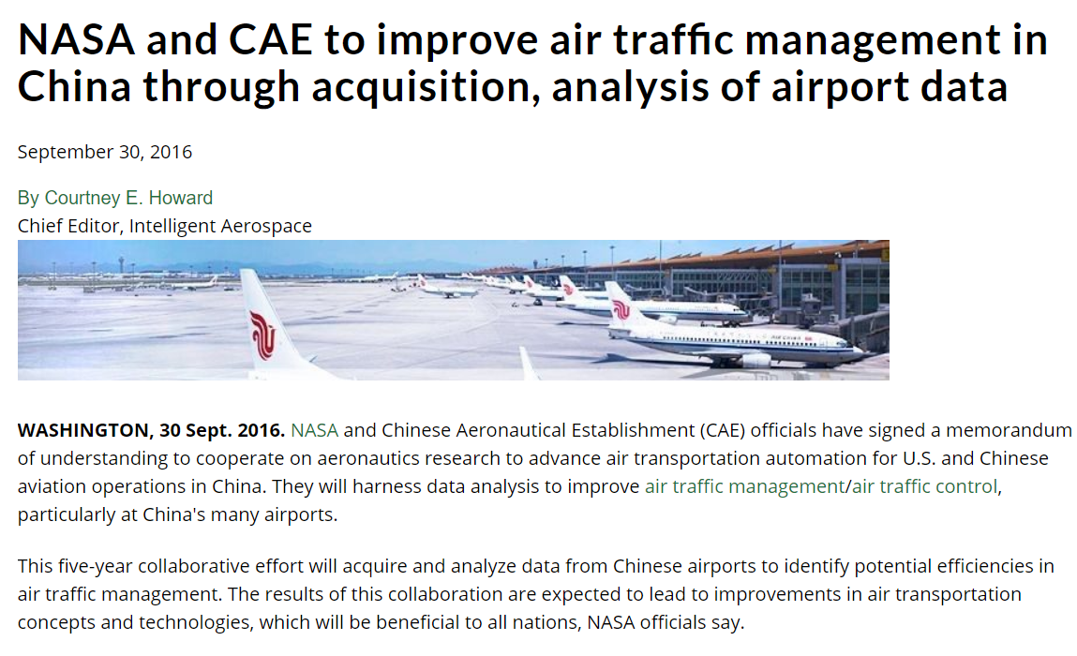
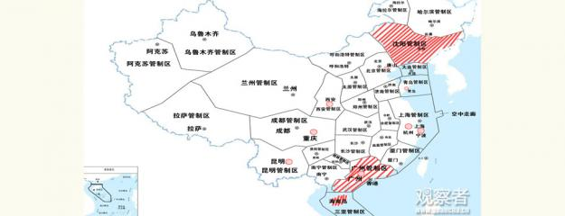
The opportunities
Aircraft business travel is booming, which need high level ATM services
Open sky policy-30% low-altitude airspace(below 1000m) opened up to general aviation flights from 2015
International co-operation with advanced administrative department, e.g. NASA
Notes:
The air traffic management authorities said on Sunday that the airspace of more than ten regions across the country below 1,000 meters will be open to general aviation flights, including all flights other than military, scheduled airline and regular cargo flights, both private and commercial.
The ten regions include Shenyang flight control zone, Guangzhou flight control zone, Tangshan, Changchun, Xi'an, Qingdao, Hangzhou, Ningbo, Kunming, Chongqing and Hainan Island.
The central government had announced a relaxation of the ban on usage of low-altitude airspace in 2010, but never gave a certain schedule. The latest statement finalized the go ahead for low-altitude private and commercial flights.
This policy will promote the development of aviation manufacture, air control and operation, aircraft maintenance and personnel training industries. It will also attract global giants to whirl into China.
At present, China has 189 enterprises opening to air traffic who own 1654 aircrafts in total.
With the opening of low-altitude airspace, China is expected to have more than 5,000 civil aircraft and two million hour flight times per year by 2020, said Wang Zhiqing, vice director of China's Civil Aviation Administration.

Slide 5
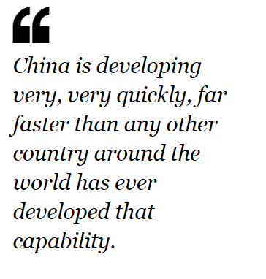
Leads for improvement
The awareness from country
adopting the best practices in the aviation industry
training crews to be more efficient as they maneuver the planes to improving its air-traffic control capabilities and the lighting on the runways
If the military transferred just 10% of its airspace to passenger planes, it could boost China’s GDP by 200billion RMB ($32.6bn).

